Slide 1
Expedia Hotel RecomMendation

Slide 2
Team members
Sasha Kapoor(sk5820)
Chirag Singhal(cs4536)
Kaushal Desai(kud203)

Slide 3
Project description
Expedia wants to provide personalized hotel recommendations to their users. With hundreds, even thousands, of hotels to choose from at every destination, it's difficult to know which will suit your personal preferences.
We plan to recommend hotels to users based on their booking history and search preferences.

Slide 4
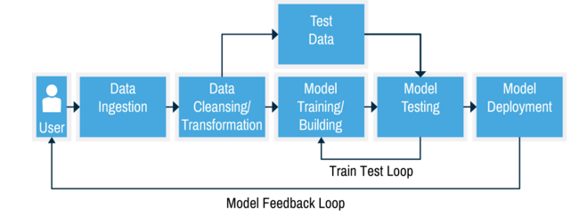
Project Overflow

Slide 5
Data Sources
Data is provided by expedia on kaggle competitions. The train and test datasets are split based on time: training data from 2013 and 2014, while test data are from 2015.
train.csv - Training data includes all the users in the logs, including both click events and booking events.
test.csv – Test data only includes booking events.
destinations.csv - hotel search latent attributes

Slide 6
Technologies used-
Framework- Spark 1.6.0
Programming Language- Python 2.6.6, Scala 1.6.0
Libraries- Spark MLlib 1.6
Tools- Microsoft Azure Machine Learning Studio, Rapid Miner
Deployment Platforms-Windows PC,NYU HPC Dumbo cluster, IntelliJ

Slide 7
What is a recommender system?
Recommender systems are a subclass of information filtering system that seek to predict the "rating" or "preference" that a user would give to an item.
Recommender systems identify recommendations autonomously for individual users based on past purchases and searches, and on other users' behavior.

Slide 8
Types of recommender system
Content-based systems examine properties of the items recommended. For instance, if a Netflix user has watched many cowboy movies, then recommend a movie classified in the database as having the “cowboy”.
Collaborative filtering systems recommend items based on similarity measures between users and/or items. The items recommended to a user are those preferred by similar users.

Slide 9
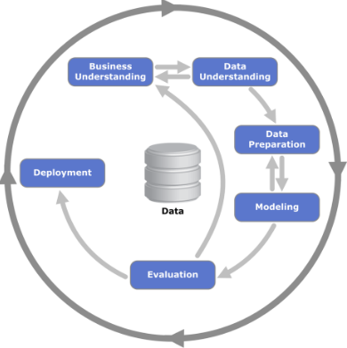
Process OverView
Data mining model used: CRISP-DM
Business Understanding
Data Understanding
Data Preparation
Modelling
Evaluation
Deployment

Slide 10
Business understanding
Hospitality industry thrives on recommendations.
Help users find a hotel catering to their needs and requirements.
Consideration of other factors is required to provide a more accurate prediction.

Slide 11
Data understanding
Explored the Dataset which was structured.
Understood the data types, their meaning and importance w.r.t business.
The process looped back to Business Understanding to get a in-depth view of data
Help users find a hotel catering to their needs and requirements.
Primarily the data had fields like is_booking,is_package,is_mobile,srch_ci,srch_co,hotel_country,hotel_continent etc.

Slide 12
Data preparation
Implemented various data cleaning, data reduction and feature selection techniques and their combinations:
Replace Missing Values
Low Variance Filter
High Correlation Filter
Principal Component Analysis
Filter Based Feature Selection

Slide 13
Data preparation
In Filter based feature selection, we used different correlation methods:
Pearson Correlation
Fisher Score
Chi Squared
Spearman Correlation

Slide 14
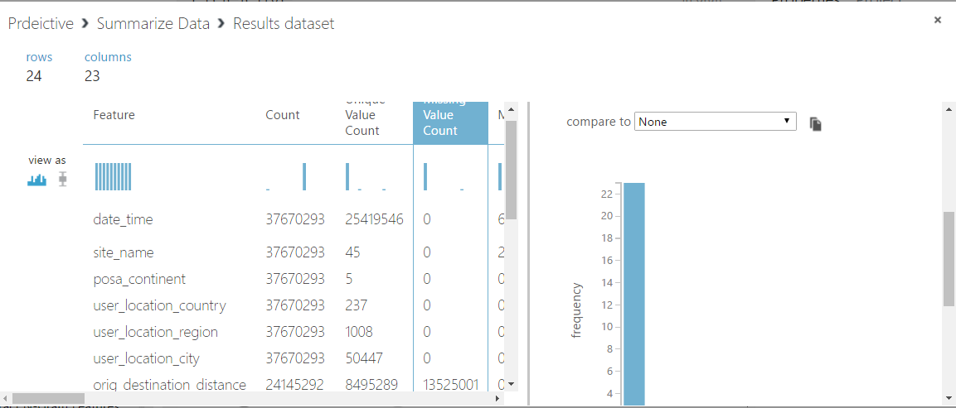
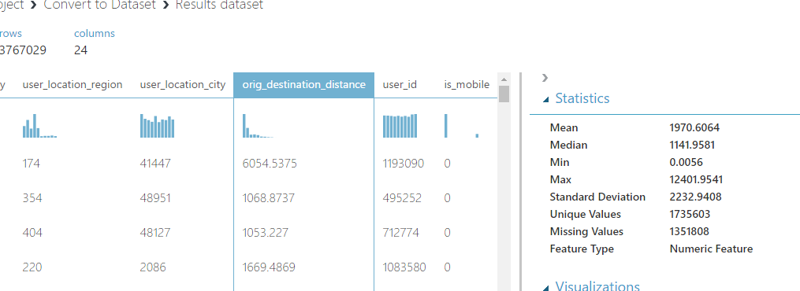
Using MS Azure, we see where are the missing values in the data.

Slide 15
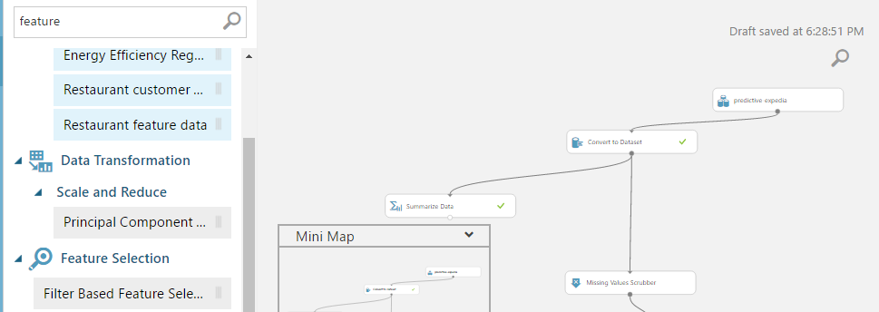
Replacing missing values MS Azure

Slide 16
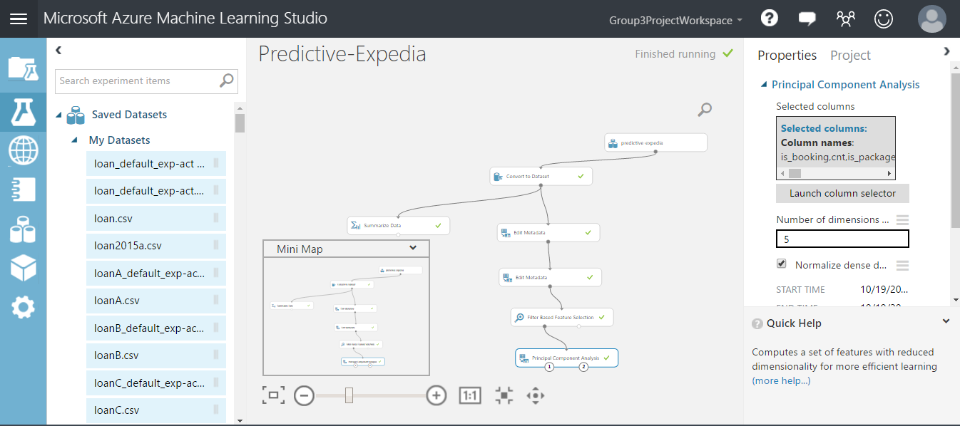
Applying Principal Component Analysis

Slide 17

Using MLlib
MLlib is built on Apache Spark, which is a fast and general engine for large scale processing. It’s running time is up to 100x faster than Hadoop MapReduce, or 10x faster on disk and it supports writing applications in Java, Scala, or Python.
MLlib is Spark’s scalable machine learning library consisting of common learning algorithms and utilities, including classification, regression, clustering, collaborative filtering, dimensionality reduction etc.
In our recommender system, we have majorly used ML algorithm for clustering like K-means and Gaussian Mixtures.
MLlib

Slide 18
modelling
A user may or may not book hotel for his/her stay. Classification is an approach to identify whether a given user will book a hotel or not.
Below mentioned are the classification algorithms we used for our project.
Neural Networks
Decision Tree
Support Vector Machines
Logistic Regression

Slide 19
modelling
Classification-
Classification Algorithm used | Recall | AUC | Notes
Neural Networks | 0.711 | 0.748 | Microsoft Azure used, Threshold-0.1
Boosted Decision Tree | 0.651 | 0.772 | Microsoft Azure used, Threshold-0.1
Logistic Regression | 0.713 | 0.735 | Microsoft Azure used, Threshold-0.1
Support Vector Machine | 0.576 | 0.702 | Microsoft Azure used, Threshold-0.1

Slide 20
modelling
We built two recommender systems. In one of the recommender systems , we used K-means clustering. K-Means clustering intends to partition n objects into k clusters in which each object belongs to the cluster with the nearest mean. This method produces exactly k different clusters of greatest possible distinctions.

Slide 22
code

Slide 23
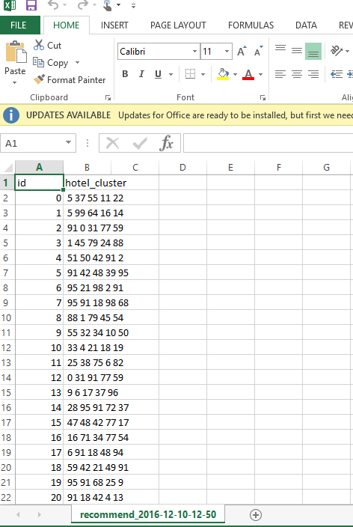
Recommender System Output
As we can see in the screenshot attached, for each user id, we recommended different hotel clusters. There were about a total of 800,000 users for whom our recommender system recommended hotels.

Slide 24
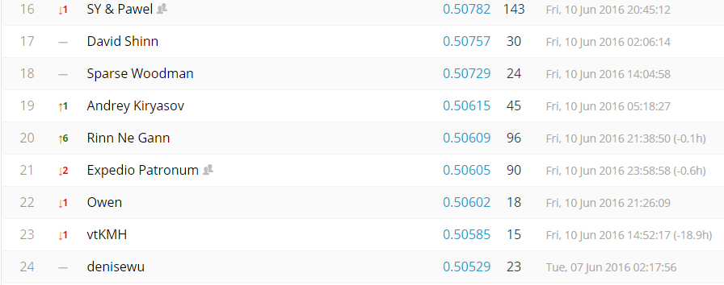
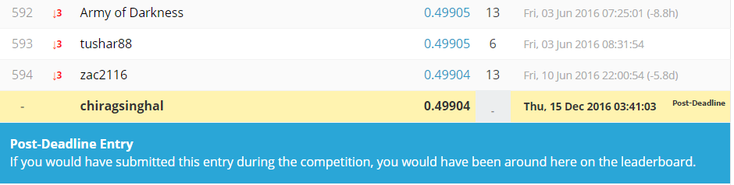
Kaggle result
We submitted our result on kaggle in which 3000 teams were competing and got 595 rank, with an accuracy of 0.49904. We can see that if our accuracy would have increased by 0.1, we would have been there in top 20.

Slide 25
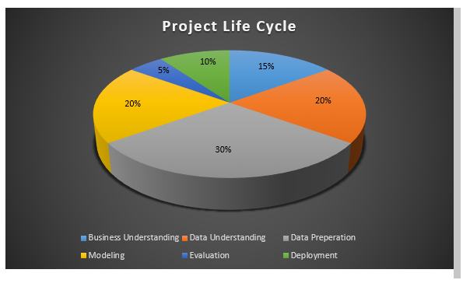
Overall project lifecycle

Slide 26
Thank You

